Slide 1


Slide 2
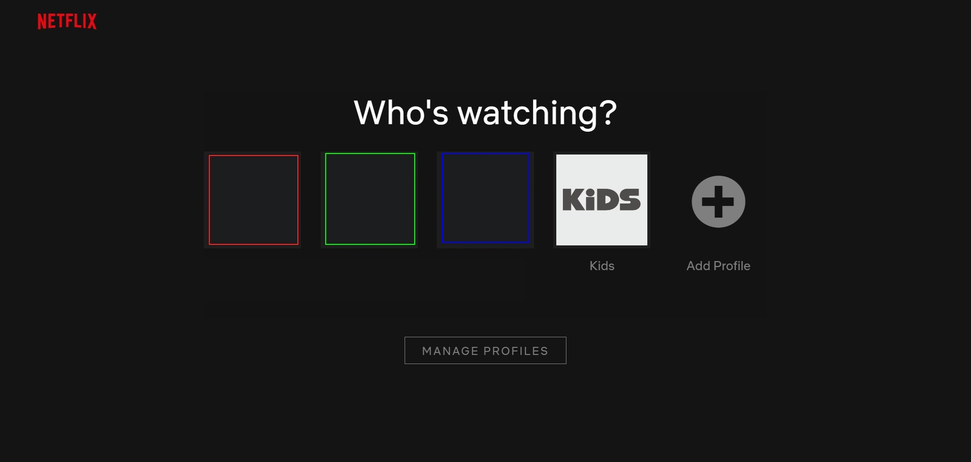




NETFLIX RFP PRESENTATION
MANIMOZHI NEETHINAYAGAM
SHREYAS BELUR MANJUNATHA SWAMY
ABHIRAM
NATAKARANI
JEREMY
ESQUIVIAS

Slide 3
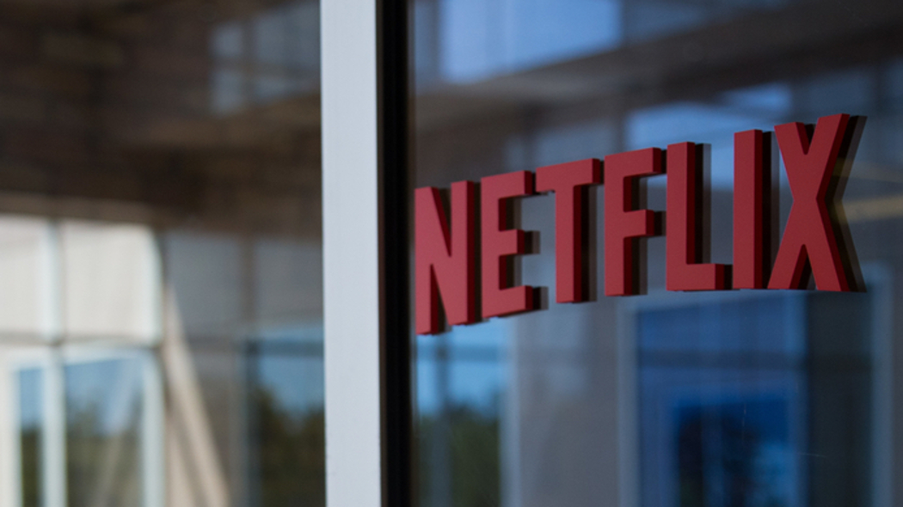
Agenda
Introduction
Transformation
Budget
Timeline
Call to Action

Slide 4
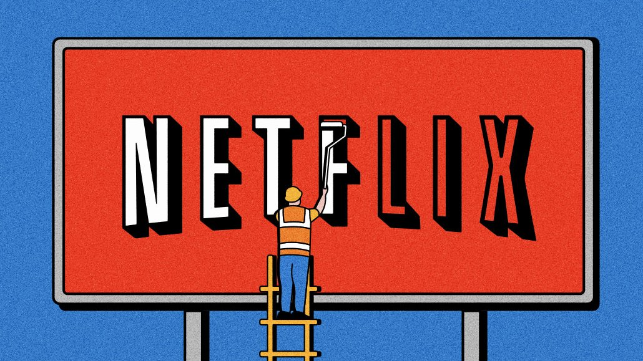
INTRODUCTION
Q1: Loss of 2 million subscribers.
Stock dropped by 68%.
Focus: Increase new subscribers.
Combat Password Sharing
Expand Animated Web Series
Attractive Subscription Discounts
Leverage AI Technology

Slide 5
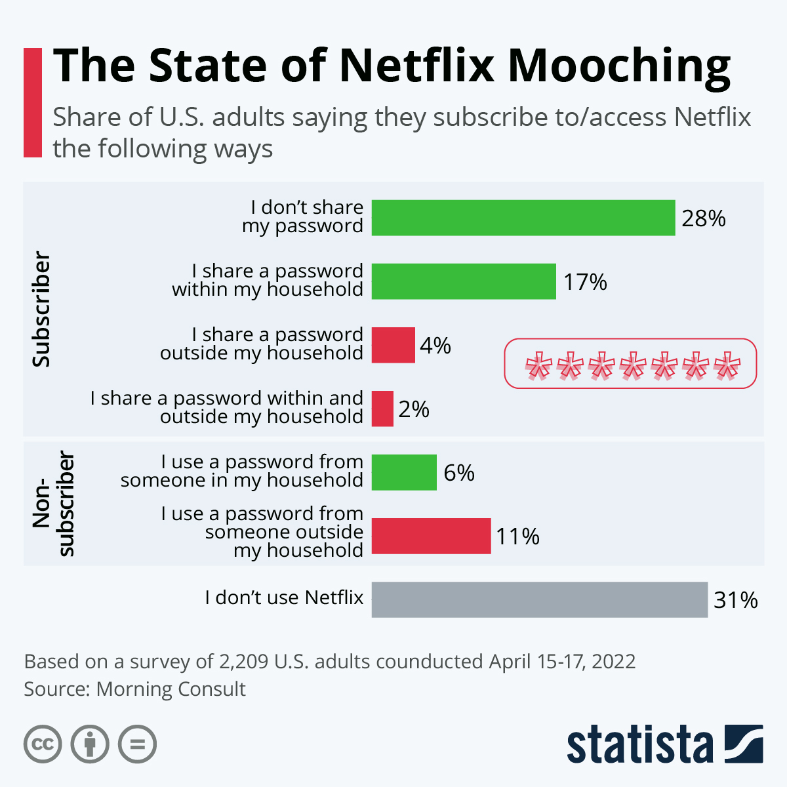
RESTRICT PASSWORD SHARING
PRESENT TECH:
Restrict through device login and screen limitations.
FUTURE TECH:
Device Verification through four-digit code
Utilize AI and ML to identify unusual patterns in usage.
Flag Potential Account Sharing.
PREVENT LOSS OF REVENUE

Slide 6

INCREASE Animated Web Series
PRESENT TECH:
Team receives content pitches.
works with talent agencies and creative community for project ideas.
FUTURE TECH:
Kid-Friendly Short Content.
Interactive UX with Voice Recommendations.
Personalized Game Recommendations.
Kids are users and parents are customers.

Slide 7

New SUBSCRIPTION PLAN:
PRESENT PLAN:
New subscribers will get one-month free subscription.
4 different devices at the same time with Premium subscription.
2 with Standard or Standard with advertisement subscription.
And 1 with Basic subscription.
FUTURE:
Providing a cost-effective alternative to encourage individual subscriptions.
innovative subscription plans to attract a wider audience.
Special discount for college students.

Slide 8

AI Implementation
PRESENT TECH:
item-item similarity algorithm.
FUTURE TECH:
Non-Intrusive Ad Placements
Catchy Thumbnail Annotations

Slide 9

BUDGET ALLOCATION PLAN:
Netflix proposes a budget of $10 million for the next fiscal year (2023-2024) to continue to grow our customer base and expand our content offerings.
30% of the budget for investing in technology and infrastructure.
60% of the budget for employee salaries and benefits.
10% of the budget for marketing and advertising

Slide 10
TIMELINE
June 2023
Discovery 2 weeks
Target Date: May 30, 2023
Requirements - 4 weeks Target Date: June 17, 2023
August 2023
UAT 1 - 2 weeks.
Target Date: August 26, 2023
Go Live 1 - 1 week, Target Date: September 2, 2023
October 2023
Programming Sprint 2 - 8 weeks
Programming Sprint 1 -8 weeks, Target Date: August 12, 2023.
August 2023
Target Date: October 28, 2023
November 2023
UAT 2 - 2 weeks, Target Date: November 11, 2023
November 2023
September 2023
Go Live 2 - 1 week, Target Date: November 18, 2023

Slide 11
Call to Action
Requesting for your approval
Any further clarifications/questions or need for another meeting
Need to establish any common grounds with respect to budget or timeline
​Pilot program

Slide 12

THANK YOU

